Slide 1
GMOs
How genetic modification influences the nutrition of a genetically modified organism (GMO) used for food

Slide 2

What is a GMO?
Organisms have DNA. This includes the plants we eat.
Plant + splice of DNA from another plant = GMO

Slide 3
GMO are themselves not toxic
Breeding one plant with another plant is a GMO.
Farmers have been making ‘GMO’s for centuries.
Longitudinal Studies show GMO feed is not ‘Toxic’ to farm animals⁴
Flaws with the study
Greater capacity for hybridization.
Now we can splice in DNA.

Slide 4
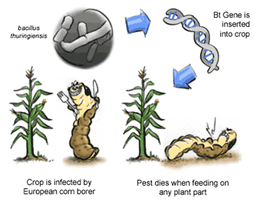
…or are they?
When Biotech goes one step too far
BT corn – Allergenicity, Lateral transfer of antibiotic properties that damage microbiota and a protein toxicity that may damage the endothelium of our gut lining.¹

Slide 5
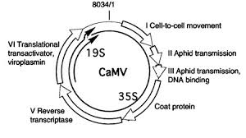
Newly discovered danger
GeneVI³
Includes various promoters
This gene is inserted for ability to increase yellow color and reduce fertility
Has been found to cause tumors in Rats /unintended phenotypic changes
Works on Ribosomes and gene silencing
Found in Roundup Ready Soybeans and MON810 Maize

Slide 6
Conventional vs Organic farming
Organic | Conventional
Crop rotation | Crop repetition
More fragile | Pest resistant (antibiotic)
Food Driven | Money Driven

Slide 7
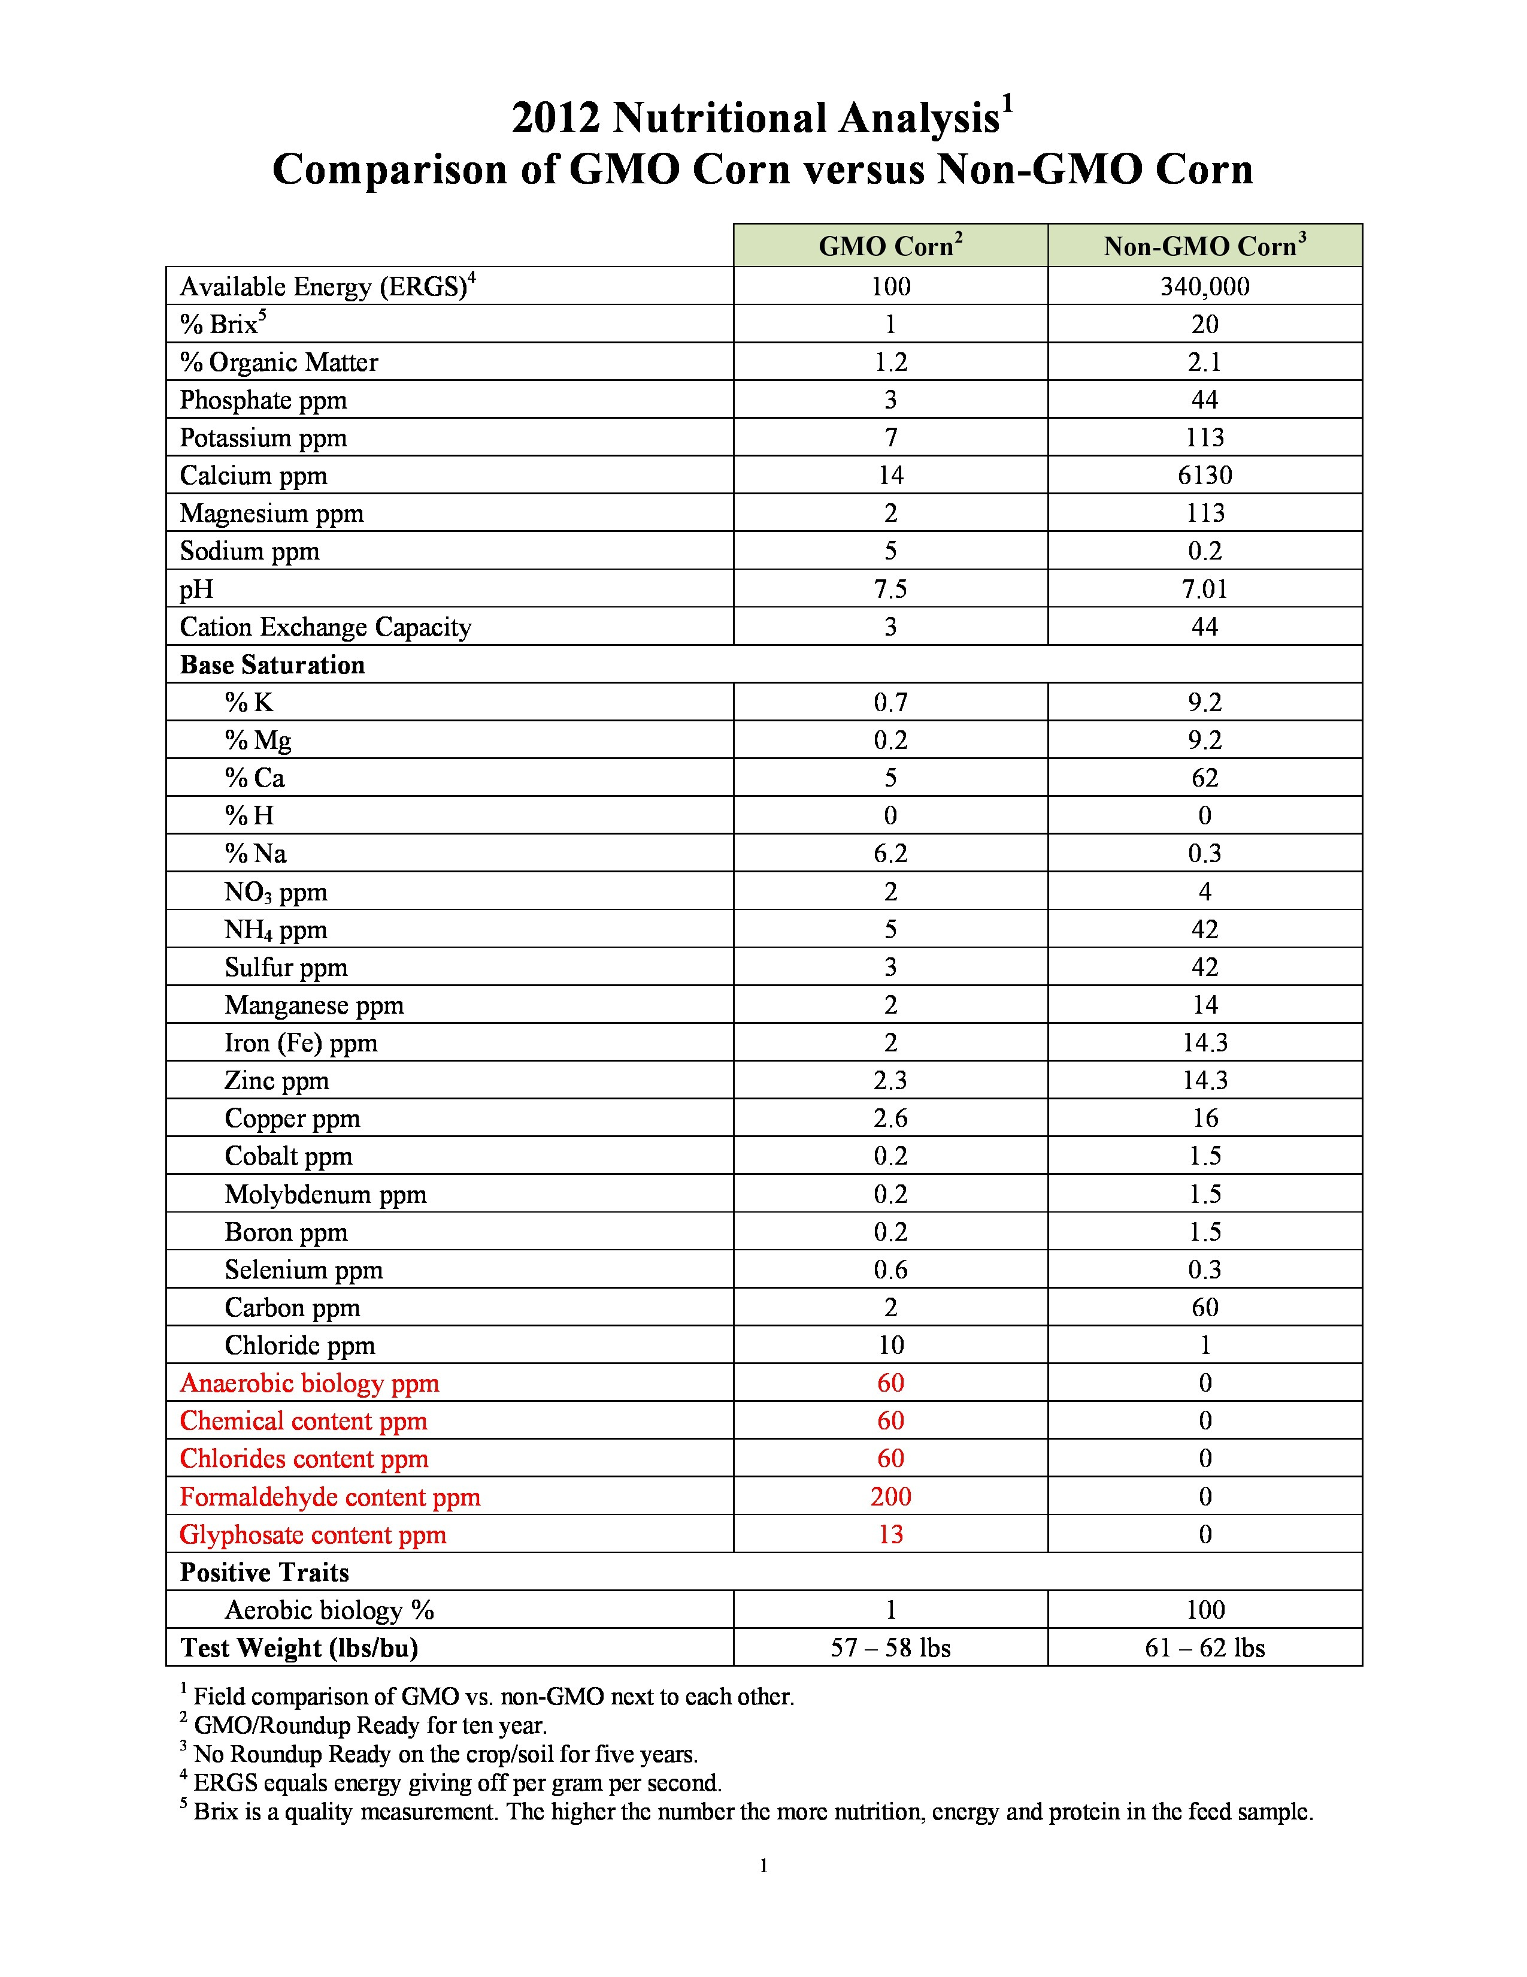
Changes in Nutritional Content²
Less Nutrients
Phosphate, Potassium, Calcium, Magnesium, Sulfur, Manganese, Iron, Zinc, Copper, Cobalt, Boron, and Molybdenum
More Harmful Substances
Chloride, Formaldehyde, and Glyphosate (Also, found in higher proportions: sodium and selenium)

Slide 8
References
1. Hardyhall. (2005, August 8). BT Corn: Is it Worth the Risk? Retrieved from Science Creative Quarterly: www.scq.ubc.ca
2. Honeycutt, Z. (2013, March 15). Blog. Retrieved from Moms Across America: http://www.momsacrossamerica.com/stunning_corn_comparison_gmo_versus_non_gmo
3. Latham J, W. A. (2013, Jan 31). Regulators discover a hidden viral gene in commercial GMO crops. Retrieved from Independant Science News: www.bibliotecapleyades.net/ciencia/ciencia_geneticfood120.htm
4. Snell C, B. A. (April 2012). Assessment of the health impact of GM plant diets in long-term and multigenerational animal feeding trials: A literature review. Food and Chemical Toxicology, 1134–1148.

